Slide 1
Snack Ordering

Slide 2
Description
We are excited to submit our proposal for the development of a comprehensive Snack Ordering System designed to streamline and enhance the snack selection and purchasing experience. Our solution will include a user-friendly platform, allowing customers to easily browse, select, and purchase their favorite snacks. The system will feature a dynamic menu with real-time inventory updates, seamless payment integration, and order tracking capabilities. Our team will ensure that the platform is scalable, secure, and optimized for both web and mobile devices. Additionally, we will incorporate an intuitive admin panel for managing product listings, orders, and customer data. We are committed to delivering a high-quality solution on time and within budget, with full support and maintenance post-launch to ensure continued functionality and success.

Slide 3
LoginActivity.kt
package com.example.snackordering
import android.content.Context
import android.content.Intent import android.os.Bundle
import androidx.activity.ComponentActivity
import androidx.activity.compose.setContent import androidx.compose.foundation.Image import androidx.compose.foundation.layout.* import androidx.compose.material.*
import androidx.compose.runtime.* import androidx.compose.ui.Alignment import androidx.compose.ui.Modifier
import androidx.compose.ui.graphics.Color
import androidx.compose.ui.layout.ContentScale import androidx.compose.ui.res.painterResource import androidx.compose.ui.text.font.FontFamily import androidx.compose.ui.text.font.FontWeight import androidx.compose.ui.unit.dp
import androidx.compose.ui.unit.sp
import androidx.core.content.ContextCompat
import com.example.snackordering.ui.theme.SnackOrderingTheme
class LoginActivity : ComponentActivity() {
private lateinit var databaseHelper: UserDatabaseHelper override fun onCreate(savedInstanceState: Bundle?) {
super.onCreate(savedInstanceState)
databaseHelper = UserDatabaseHelper(this) setContent {
SnackOrderingTheme {
// A surface container using the 'background' color from the theme Surface(
modifier = Modifier.fillMaxSize(),
color = MaterialTheme.colors.background
) {
LoginScreen(this, databaseHelper)
}
}
}
}
}
@Composable
fun LoginScreen(context: Context, databaseHelper: UserDatabaseHelper) {

Slide 4
Image(painterResource(id = R.drawable.order), contentDescription = "",
alpha =0.3F,
contentScale = ContentScale.FillHeight,
)
var username by remember { mutableStateOf("") }
var password by remember { mutableStateOf("") } var error by remember { mutableStateOf("") }
Column(
modifier = Modifier.fillMaxSize(), horizontalAlignment = Alignment.CenterHorizontally, verticalArrangement = Arrangement.Center
) {
Text(
fontSize = 36.sp,
fontWeight = FontWeight.ExtraBold, fontFamily = FontFamily.Cursive, color = Color.White,
text = "Login"
)
Spacer(modifier = Modifier.height(10.dp))
TextField(
value = username,
onValueChange = { username = it }, label = { Text("Username") }, modifier = Modifier.padding(10.dp)
.width(280.dp)
)
TextField(
value = password,
onValueChange = { password = it }, label = { Text("Password") },
modifier = Modifier.padding(10.dp)
.width(280.dp)
)

Slide 5
if (error.isNotEmpty()) {
Text(
text = error,
color = MaterialTheme.colors.error,
modifier = Modifier.padding(vertical = 16.dp)
)
}
Button(
onClick = {
if (username.isNotEmpty() && password.isNotEmpty()) {
val user = databaseHelper.getUserByUsername(username) if (user != null && user.password == password) {
error = "Successfully log in" context.startActivity(
Intent(
context, MainPage::class.java
)
)
//onLoginSuccess()
}
if (user != null && user.password == "admin") { error = "Successfully log in"
context.startActivity( Intent(
context, AdminActivity::class.java
)
)
}
else {
error = "Invalid username or password"
}
} else {
error = "Please fill all fields"
}
},
modifier = Modifier.padding(top = 16.dp)

Slide 6
) {
Text(text = "Login")
}
Row {
TextButton(onClick = {context.startActivity( Intent(
context, MainActivity::class.java
)
)}
)
{ Text(color = Color.White,text = "Sign up") } TextButton(onClick = {
})
{
Spacer(modifier = Modifier.width(60.dp)) Text(color = Color.White,text = "Forget password?")
}
}
}
}
private fun startMainPage(context: Context) {
val intent = Intent(context, MainPage::class.java) ContextCompat.startActivity(context, intent, null)
}
MainPage.kt
package com.example.snackordering
import android.annotation.SuppressLint
import android.content.Context import android.os.Bundle import android.widget.Toast
import androidx.activity.ComponentActivity import androidx.activity.compose.setContent import androidx.annotation.DrawableRes import androidx.annotation.StringRes import androidx.compose.foundation.Image
import androidx.compose.foundation.background

Slide 7
import androidx.compose.foundation.layout.*
import androidx.compose.foundation.shape.CircleShape
import androidx.compose.foundation.shape.RoundedCornerShape import androidx.compose.material.*
import androidx.compose.material.icons.Icons import androidx.compose.material.icons.filled.* import androidx.compose.runtime.Composable import androidx.compose.ui.Alignment
import androidx.compose.ui.Modifier import androidx.compose.ui.draw.clip import androidx.compose.ui.graphics.Color
import androidx.compose.foundation.lazy.LazyColumn import androidx.compose.foundation.lazy.items
import androidx.compose.material.Text import androidx.compose.ui.unit.dp
import androidx.compose.ui.graphics.RectangleShape import androidx.compose.ui.layout.ContentScale import androidx.compose.ui.platform.LocalContext import androidx.compose.ui.res.painterResource
import androidx.compose.ui.res.stringResource import androidx.compose.ui.text.font.FontWeight import androidx.compose.ui.unit.sp
import androidx.core.content.ContextCompat.startActivity
import com.example.snackordering.ui.theme.SnackOrderingTheme
import android.content.Intent as Intent1
class MainPage : ComponentActivity() {
override fun onCreate(savedInstanceState: Bundle?) { super.onCreate(savedInstanceState)
setContent { SnackOrderingTheme {
// A surface container using the 'background' color from the theme Surface(
modifier = Modifier.fillMaxSize(),
color = MaterialTheme.colors.background
) {
FinalView(this)
val context = LocalContext.current
//PopularFoodColumn(context)

Slide 8
}
}
}
}
}
@Composable
fun TopPart() {
Row(
modifier = Modifier
.fillMaxWidth()
.background(Color(0xffeceef0)), Arrangement.SpaceBetween
) {
Icon(
imageVector = Icons.Default.Add, contentDescription = "Menu Icon", Modifier
.clip(CircleShape)
.size(40.dp), tint = Color.Black,
)
Column(horizontalAlignment = Alignment.CenterHorizontally) {
Text(text = "Location", style = MaterialTheme.typography.subtitle1, color = Color.Black) Row {
Icon(
imageVector = Icons.Default.LocationOn, contentDescription = "Location",
tint = Color.Red,
)
Text(text = "Accra" , color = Color.Black)
}
}
Icon(
imageVector = Icons.Default.Notifications, contentDescription = "Notification Icon",
Modifier
.size(45.dp), tint = Color.Black,
)

Slide 9
}
}
@Composable
fun CardPart() {
Card(modifier = Modifier.size(width = 310.dp, height = 150.dp), RoundedCornerShape(20.dp)) { Row(modifier = Modifier.padding(10.dp), Arrangement.SpaceBetween) {
Column(verticalArrangement = Arrangement.spacedBy(12.dp)) { Text(text = "Get Special Discounts")
Text(text = "up to 85%", style = MaterialTheme.typography.h5) Button(onClick = {}, colors = ButtonDefaults.buttonColors(Color.White)) {
Text(text = "Claim voucher", color = MaterialTheme.colors.surface)
}
}
Image(
painter = painterResource(id = R.drawable.food_tip_im),
contentDescription = "Food Image", Modifier.size(width = 100.dp, height = 200.dp)
)
}
}
}
@Composable
fun PopularFood(
@DrawableRes drawable: Int, @StringRes text1: Int, context: Context
) {
Card(
modifier = Modifier
.padding(top=20.dp, bottom = 20.dp, start = 65.dp)
.width(250.dp)
) {
Column(
verticalArrangement = Arrangement.Top, horizontalAlignment = Alignment.CenterHorizontally
) {
Spacer(modifier = Modifier.padding(vertical = 5.dp)) Row(

Slide 10
companion object {
@Volatile
private var instance: OrderDatabase? = null
fun getDatabase(context: Context): OrderDatabase {
return instance ?: synchronized(this) {
val newInstance = Room.databaseBuilder( context.applicationContext, OrderDatabase::class.java, "order_database"
).build()
instance = newInstance newInstance
}
}
}
}
OrderDatabaseHelper
package com.example.snackordering
import android.annotation.SuppressLint
import android.content.ContentValues import android.content.Context
import android.database.Cursor
import android.database.sqlite.SQLiteDatabase import android.database.sqlite.SQLiteOpenHelper
class OrderDatabaseHelper(context: Context) :
SQLiteOpenHelper(context, DATABASE_NAME, null,DATABASE_VERSION){
companion object {
private const val DATABASE_VERSION = 1
private const val DATABASE_NAME = "OrderDatabase.db"
private const val TABLE_NAME = "order_table"
private const val COLUMN_ID = "id"
private const val COLUMN_QUANTITY = "quantity" private const val COLUMN_ADDRESS = "address"

Slide 11
}
override fun onCreate(db: SQLiteDatabase?) {
val createTable = "CREATE TABLE $TABLE_NAME (" +
"${COLUMN_ID} INTEGER PRIMARY KEY AUTOINCREMENT, " + "${COLUMN_QUANTITY} Text, " +
"${COLUMN_ADDRESS} TEXT " + ")"
db?.execSQL(createTable)
}
override fun onUpgrade(db: SQLiteDatabase?, oldVersion: Int, newVersion: Int) {
db?.execSQL("DROP TABLE IF EXISTS $TABLE_NAME")
onCreate(db)
}
fun insertOrder(order: Order) {
val db = writableDatabase val values = ContentValues()
values.put(COLUMN_QUANTITY, order.quantity) values.put(COLUMN_ADDRESS, order.address) db.insert(TABLE_NAME, null, values)
db.close()
}
@SuppressLint("Range")
fun getOrderByQuantity(quantity: String): Order? { val db = readableDatabase
val cursor: Cursor = db.rawQuery("SELECT * FROM $TABLE_NAME WHERE $COLUMN_QUANTITY = ?", arrayOf(quantity)) var order: Order? = null
if (cursor.moveToFirst()) { order = Order(
id = cursor.getInt(cursor.getColumnIndex(COLUMN_ID)),
quantity = cursor.getString(cursor.getColumnIndex(COLUMN_QUANTITY)), address = cursor.getString(cursor.getColumnIndex(COLUMN_ADDRESS)),
)
}
cursor.close()

Slide 12
db.close()
return order
}
@SuppressLint("Range")
fun getOrderById(id: Int): Order? { val db = readableDatabase
val cursor: Cursor = db.rawQuery("SELECT * FROM $TABLE_NAME WHERE $COLUMN_ID = ?", arrayOf(id.toString())) var order: Order? = null
if (cursor.moveToFirst()) { order = Order(
id = cursor.getInt(cursor.getColumnIndex(COLUMN_ID)),
quantity = cursor.getString(cursor.getColumnIndex(COLUMN_QUANTITY)), address = cursor.getString(cursor.getColumnIndex(COLUMN_ADDRESS)),
)
}
cursor.close() db.close() return order
}
@SuppressLint("Range")
fun getAllOrders(): List<Order> {
val orders = mutableListOf<Order>() val db = readableDatabase
val cursor: Cursor = db.rawQuery("SELECT * FROM $TABLE_NAME", null) if (cursor.moveToFirst()) {
do {
val order = Order(
id = cursor.getInt(cursor.getColumnIndex(COLUMN_ID)),
quantity = cursor.getString(cursor.getColumnIndex(COLUMN_QUANTITY)), address = cursor.getString(cursor.getColumnIndex(COLUMN_ADDRESS)),
)
orders.add(order)
} while (cursor.moveToNext())
}
cursor.close() db.close() return orders
}
}

Slide 13
RegisterActivity
package com.example.snackordering
import android.content.Context
import android.content.Intent import android.os.Bundle
import androidx.activity.ComponentActivity import androidx.activity.compose.setContent import androidx.compose.foundation.Image import androidx.compose.foundation.layout.* import androidx.compose.material.*
import androidx.compose.runtime.* import androidx.compose.ui.Alignment import androidx.compose.ui.Modifier
import androidx.compose.ui.graphics.Color import androidx.compose.ui.layout.ContentScale import androidx.compose.ui.res.painterResource import androidx.compose.ui.text.font.FontFamily import androidx.compose.ui.text.font.FontWeight import androidx.compose.ui.unit.dp
import androidx.compose.ui.unit.sp
import androidx.core.content.ContextCompat
import com.example.snackordering.ui.theme.SnackOrderingTheme
class MainActivity : ComponentActivity() {
private lateinit var databaseHelper: UserDatabaseHelper override fun onCreate(savedInstanceState: Bundle?) {
super.onCreate(savedInstanceState) databaseHelper = UserDatabaseHelper(this) setContent {
SnackOrderingTheme {
// A surface container using the 'background' color from the theme Surface(
modifier = Modifier.fillMaxSize(),
color = MaterialTheme.colors.background
) {
RegistrationScreen(this,databaseHelper)
}

Slide 14
}
}
}
}
@Composable
fun RegistrationScreen(context: Context, databaseHelper: UserDatabaseHelper) {
Image(
painterResource(id = R.drawable.order), contentDescription = "", alpha =0.3F,
contentScale = ContentScale.FillHeight,
)
var username by remember { mutableStateOf("") }
var password by remember { mutableStateOf("") } var email by remember { mutableStateOf("") }
var error by remember { mutableStateOf("") }
Column(
modifier = Modifier.fillMaxSize(), horizontalAlignment = Alignment.CenterHorizontally, verticalArrangement = Arrangement.Center
) {
Text(
fontSize = 36.sp,
fontWeight = FontWeight.ExtraBold, fontFamily = FontFamily.Cursive, color = Color.White,
text = "Register"
)
Spacer(modifier = Modifier.height(10.dp))
TextField(
value = username,
onValueChange = { username = it }, label = { Text("Username") }, modifier = Modifier

Slide 15
.padding(10.dp)
.width(280.dp)
)
TextField(
value = email,
onValueChange = { email = it }, label = { Text("Email") }, modifier = Modifier
.padding(10.dp)
.width(280.dp)
)
TextField(
value = password,
onValueChange = { password = it }, label = { Text("Password") }, modifier = Modifier
.padding(10.dp)
.width(280.dp)
)
if (error.isNotEmpty()) {
Text(
text = error,
color = MaterialTheme.colors.error,
modifier = Modifier.padding(vertical = 16.dp)
)
}
Button(
onClick = {
if (username.isNotEmpty() && password.isNotEmpty() && email.isNotEmpty()) { val user = User(
id = null,
firstName = username, lastName = null,
email = email, password = password

Slide 16
Spacer(modifier = Modifier.padding(10.dp))
TextField(value = address, onValueChange = {address=it},
label = { Text("Address") }, modifier = Modifier
.padding(10.dp)
.width(280.dp))
Spacer(modifier = Modifier.padding(10.dp))
if (error.isNotEmpty()) {
Text(
text = error,
color = MaterialTheme.colors.error,
modifier = Modifier.padding(vertical = 16.dp)
)
}
Button(onClick = {
if( quantity.isNotEmpty() and address.isNotEmpty()){ val order = Order(
id = null,
quantity = quantity, address = address
)
orderDatabaseHelper.insertOrder(order)
Toast.makeText(mContext, "Order Placed Successfully", Toast.LENGTH_SHORT).show()}
},
colors = ButtonDefaults.buttonColors(backgroundColor = Color.White))
{
Text(text = "Order Place", color = Color.Black)
}
}
}
private fun startMainPage(context: Context) {
val intent = Intent(context, LoginActivity::class.java)

Slide 17
UserDatabase
package com.example.snackordering
import android.content.Context
import androidx.room.Database import androidx.room.Room
import androidx.room.RoomDatabase
@Database(entities = [User::class], version = 1)
abstract class UserDatabase : RoomDatabase() {
abstract fun userDao(): UserDao
companion object {
@Volatile
private var instance: UserDatabase? = null
fun getDatabase(context: Context): UserDatabase {
return instance ?: synchronized(this) {
val newInstance = Room.databaseBuilder( context.applicationContext, UserDatabase::class.java, "user_database"
).build()
instance = newInstance newInstance
}
}
}
}
UserDatabaseHelper
package com.example.snackordering
import android.annotation.SuppressLint
import android.content.ContentValues import android.content.Context
import android.database.Cursor
import android.database.sqlite.SQLiteDatabase

Slide 18
import android.database.sqlite.SQLiteOpenHelper
class UserDatabaseHelper(context: Context) :
SQLiteOpenHelper(context, DATABASE_NAME, null, DATABASE_VERSION) {
companion object {
private const val DATABASE_VERSION = 1
private const val DATABASE_NAME = "UserDatabase.db"
private const val TABLE_NAME = "user_table"
private const val COLUMN_ID = "id"
private const val COLUMN_FIRST_NAME = "first_name"
private const val COLUMN_LAST_NAME = "last_name" private const val COLUMN_EMAIL = "email"
private const val COLUMN_PASSWORD = "password"
}
override fun onCreate(db: SQLiteDatabase?) {
val createTable = "CREATE TABLE $TABLE_NAME (" + "$COLUMN_ID INTEGER PRIMARY KEY AUTOINCREMENT, " + "$COLUMN_FIRST_NAME TEXT, " +
"$COLUMN_LAST_NAME TEXT, " + "$COLUMN_EMAIL TEXT, " + "$COLUMN_PASSWORD TEXT" + ")"
db?.execSQL(createTable)
}
override fun onUpgrade(db: SQLiteDatabase?, oldVersion: Int, newVersion: Int) {
db?.execSQL("DROP TABLE IF EXISTS $TABLE_NAME")
onCreate(db)
}
fun insertUser(user: User) {
val db = writableDatabase val values = ContentValues()
values.put(COLUMN_FIRST_NAME, user.firstName)
values.put(COLUMN_LAST_NAME, user.lastName) values.put(COLUMN_EMAIL, user.email) values.put(COLUMN_PASSWORD, user.password)

Slide 19
db.insert(TABLE_NAME, null, values)
db.close()
}
@SuppressLint("Range")
fun getUserByUsername(username: String): User? { val db = readableDatabase
val cursor: Cursor = db.rawQuery("SELECT * FROM $TABLE_NAME WHERE $COLUMN_FIRST_NAME = ?", arrayOf(username))
var user: User? = null
if (cursor.moveToFirst()) { user = User(
id = cursor.getInt(cursor.getColumnIndex(COLUMN_ID)),
firstName = cursor.getString(cursor.getColumnIndex(COLUMN_FIRST_NAME)), lastName = cursor.getString(cursor.getColumnIndex(COLUMN_LAST_NAME)), email = cursor.getString(cursor.getColumnIndex(COLUMN_EMAIL)),
password = cursor.getString(cursor.getColumnIndex(COLUMN_PASSWORD)),
)
}
cursor.close() db.close() return user
}
@SuppressLint("Range")
fun getUserById(id: Int): User? { val db = readableDatabase
val cursor: Cursor = db.rawQuery("SELECT * FROM $TABLE_NAME WHERE $COLUMN_ID = ?", arrayOf(id.toString())) var user: User? = null
if (cursor.moveToFirst()) { user = User(
id = cursor.getInt(cursor.getColumnIndex(COLUMN_ID)),
firstName = cursor.getString(cursor.getColumnIndex(COLUMN_FIRST_NAME)),
lastName = cursor.getString(cursor.getColumnIndex(COLUMN_LAST_NAME)), email = cursor.getString(cursor.getColumnIndex(COLUMN_EMAIL)),
password = cursor.getString(cursor.getColumnIndex(COLUMN_PASSWORD)),
)
}
cursor.close() db.close()
return user
}

Slide 20
@SuppressLint("Range")
fun getAllUsers(): List<User> {
val users = mutableListOf<User>() val db = readableDatabase
val cursor: Cursor = db.rawQuery("SELECT * FROM $TABLE_NAME", null) if (cursor.moveToFirst()) {
do {
val user = User(
id = cursor.getInt(cursor.getColumnIndex(COLUMN_ID)),
firstName = cursor.getString(cursor.getColumnIndex(COLUMN_FIRST_NAME)), lastName = cursor.getString(cursor.getColumnIndex(COLUMN_LAST_NAME)),
email = cursor.getString(cursor.getColumnIndex(COLUMN_EMAIL)), password = cursor.getString(cursor.getColumnIndex(COLUMN_PASSWORD)),
)
users.add(user)
} while (cursor.moveToNext())
}
cursor.close() db.close() return users
}
}
THEME
Color
package com.example.snackordering.ui.theme
import androidx.compose.ui.graphics.Color
val Purple200 = Color(0xFFBB86FC)
val Purple500 = Color(0xFF6200EE) val Purple700 = Color(0xFF3700B3) val Teal200 = Color(0xFF03DAC5)
Shape
package com.example.snackordering.ui.theme
import androidx.compose.foundation.shape.RoundedCornerShape

Slide 21
import androidx.compose.material.Shapes
import androidx.compose.ui.unit.dp
val Shapes = Shapes(
small = RoundedCornerShape(4.dp), medium = RoundedCornerShape(4.dp), large = RoundedCornerShape(0.dp)
)
Theme
package com.example.snackordering.ui.theme
import androidx.compose.foundation.isSystemInDarkTheme
import androidx.compose.material.MaterialTheme import androidx.compose.material.darkColors import androidx.compose.material.lightColors import androidx.compose.runtime.Composable
private val DarkColorPalette = darkColors(
primary = Purple200, primaryVariant = Purple700, secondary = Teal200
)
private val LightColorPalette = lightColors(
primary = Purple500,
primaryVariant = Purple700, secondary = Teal200
/* Other default colors to override
background = Color.White, surface = Color.White, onPrimary = Color.White, onSecondary = Color.Black, onBackground = Color.Black, onSurface = Color.Black,
*/
)
@Composable
fun SnackOrderingTheme(

Slide 22
darkTheme: Boolean = isSystemInDarkTheme(),
content: @Composable () -> Unit
) {
val colors = if (darkTheme) { DarkColorPalette
} else {
LightColorPalette
}
MaterialTheme(
colors = colors, typography = Typography,
shapes = Shapes, content = content
)
}
Type
package com.example.snackordering.ui.theme
import androidx.compose.material.Typography
import androidx.compose.ui.text.TextStyle import androidx.compose.ui.text.font.FontFamily import androidx.compose.ui.text.font.FontWeight import androidx.compose.ui.unit.sp
// Set of Material typography styles to start with
val Typography = Typography( body1 = TextStyle(
fontFamily = FontFamily.Default, fontWeight = FontWeight.Normal, fontSize = 16.sp
)
/* Other default text styles to override button = TextStyle(
fontFamily = FontFamily.Default, fontWeight = FontWeight.W500, fontSize = 14.sp
),
caption = TextStyle(
fontFamily = FontFamily.Default,

Slide 23
fontWeight = FontWeight.Normal,
fontSize = 12.sp
)
*/
)

Slide 24
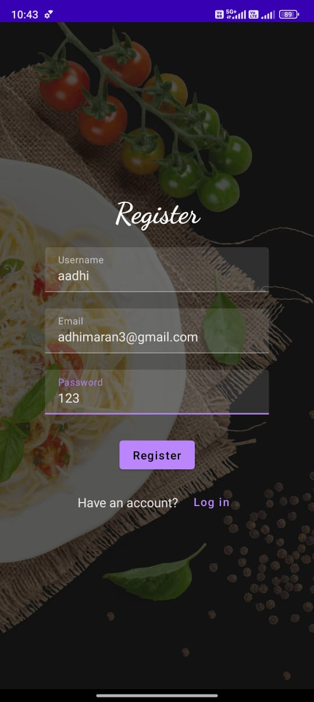
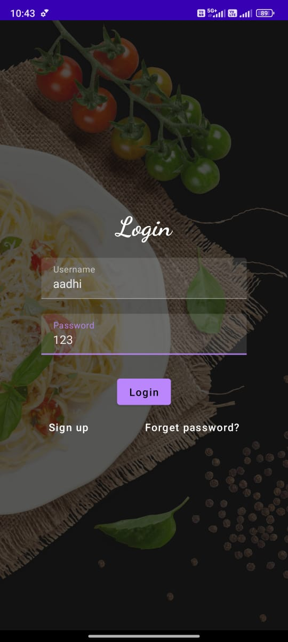

Slide 25
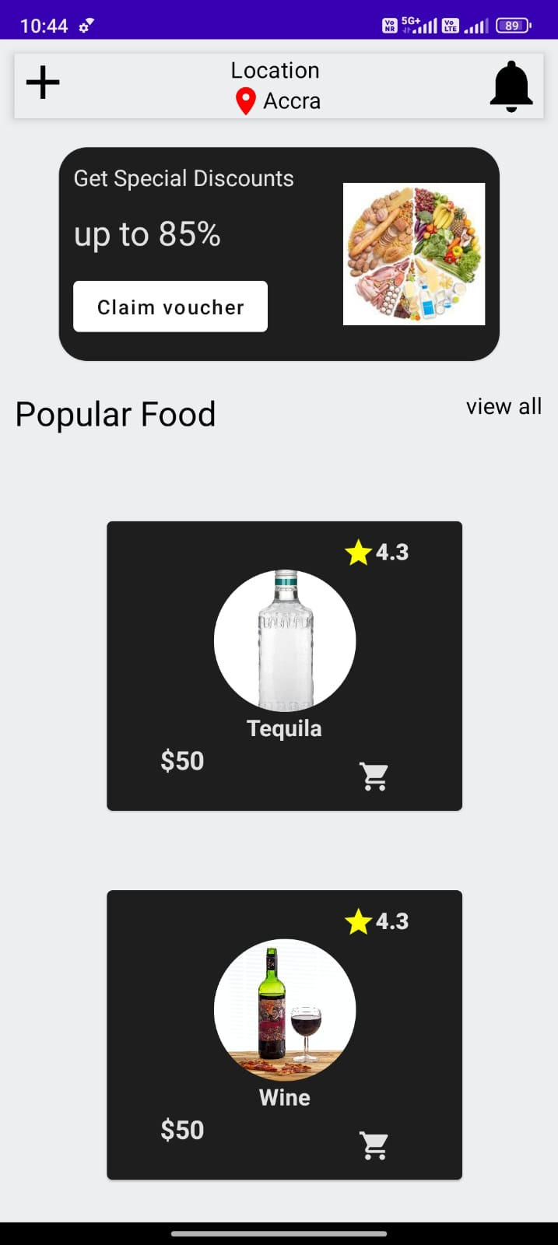
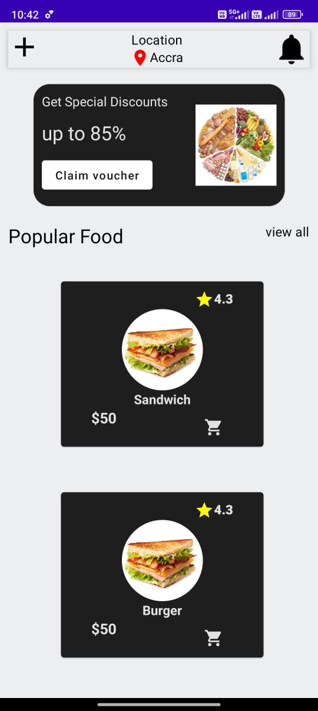

Slide 26
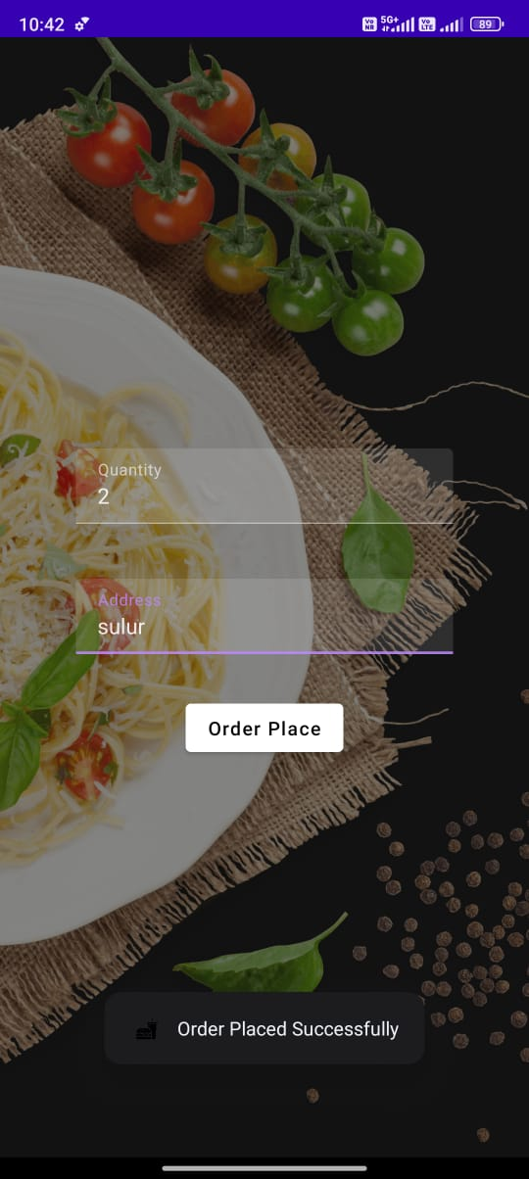

Slide 27
Thank You

